Slide 1
Microsoft Data Engineer (GIZ1_AIS4_S1e) - 2904
FINAL PROJECT :
Group 4
KHALED GAMAL 21043130
KHALED SAMI 21030095
IBRAHIM KHALED 21029821
ABDELRAHMAN MAGDY 21014510
MAZEN MOHAMAD
MAHMOUD AHMAD 1112120727

Slide 2
Welcome To Our Presentation!

Slide 3
SQL Database Schema
Overview
This schema is designed to manage customer information, transactions, and interactions.
Contains three primary tables: Customers, Transactions, and Interactions

Slide 4
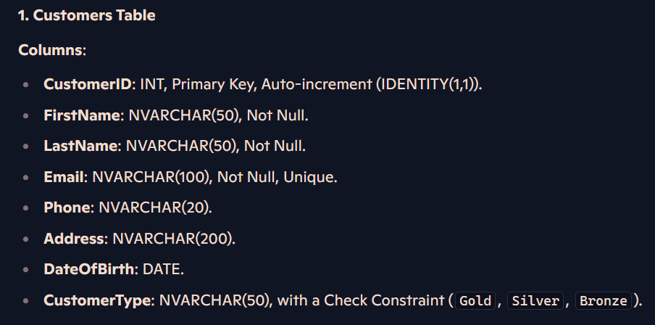
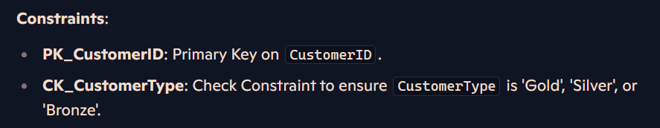
Table Structure

Slide 5
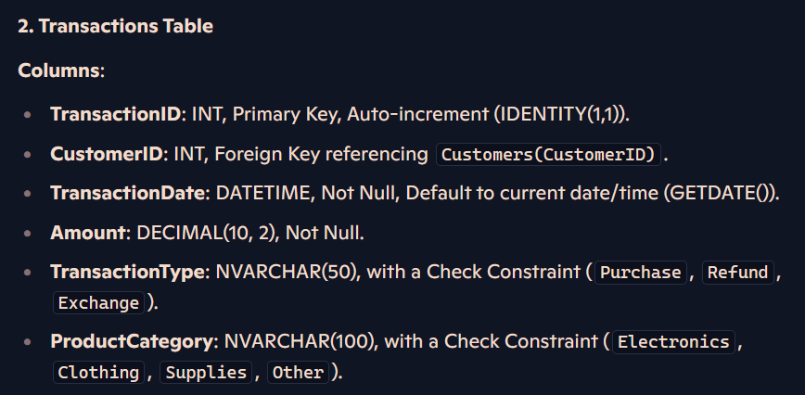
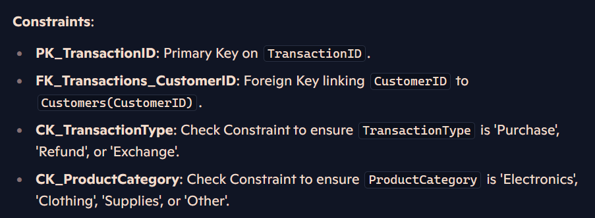

Slide 6
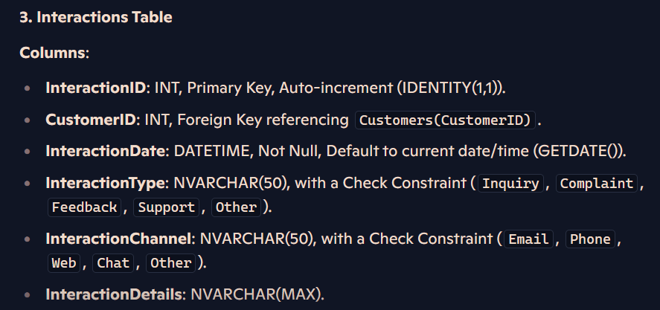
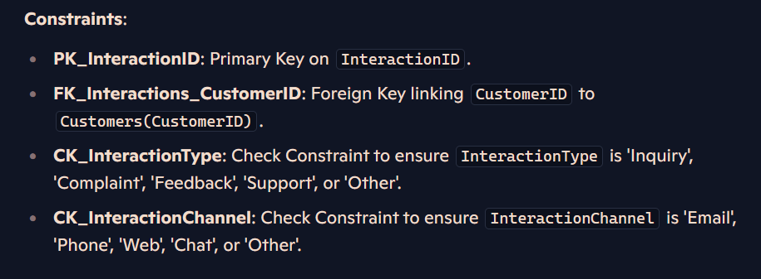

Slide 7
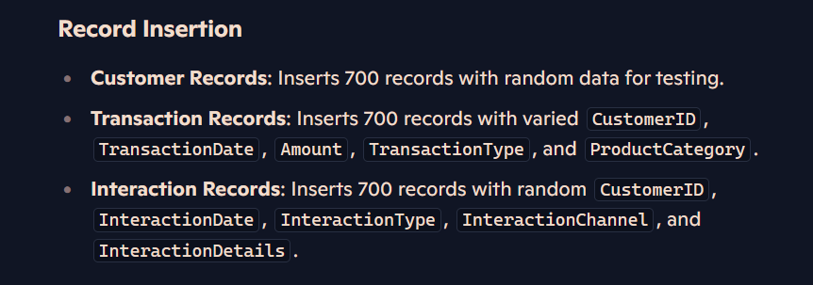

Slide 8
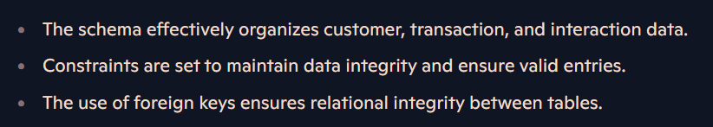

Slide 9
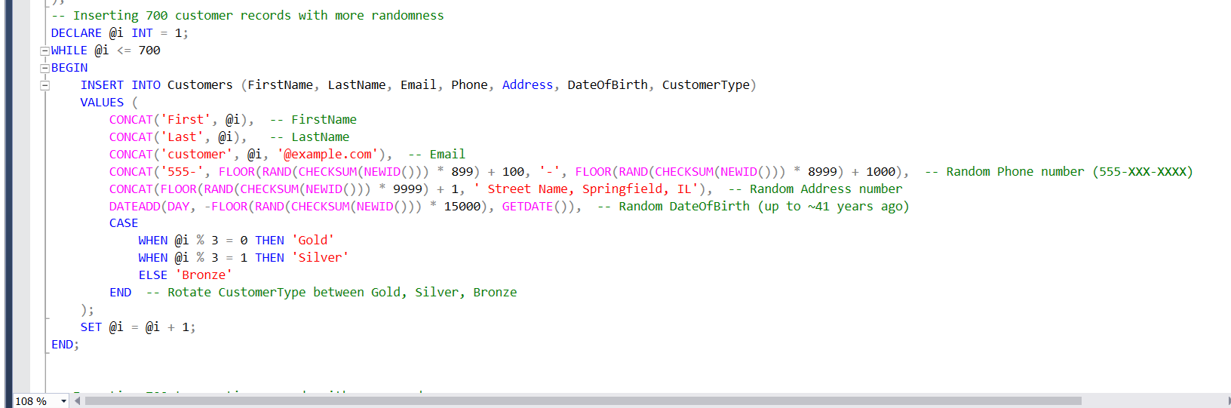

Slide 10
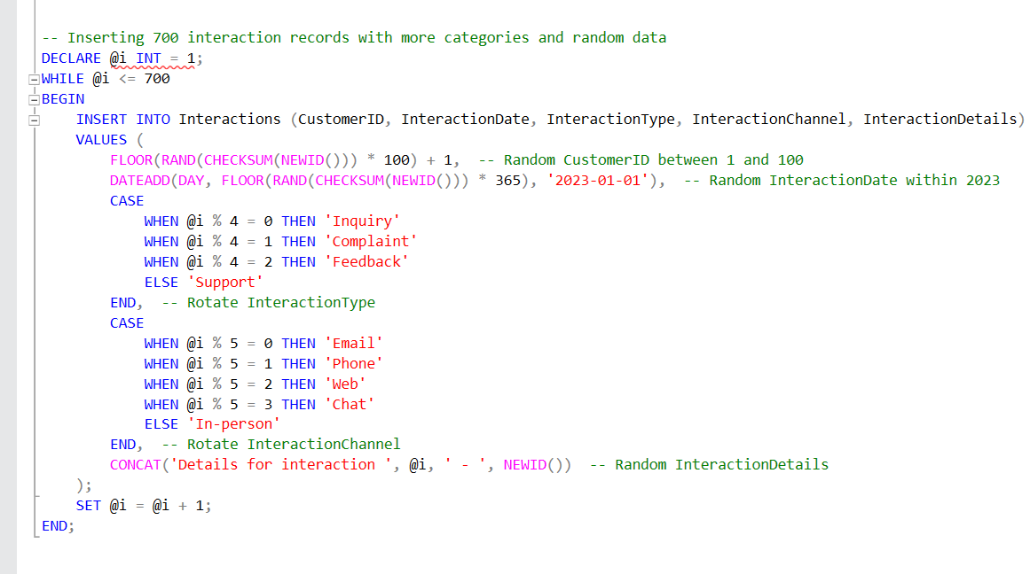

Slide 11
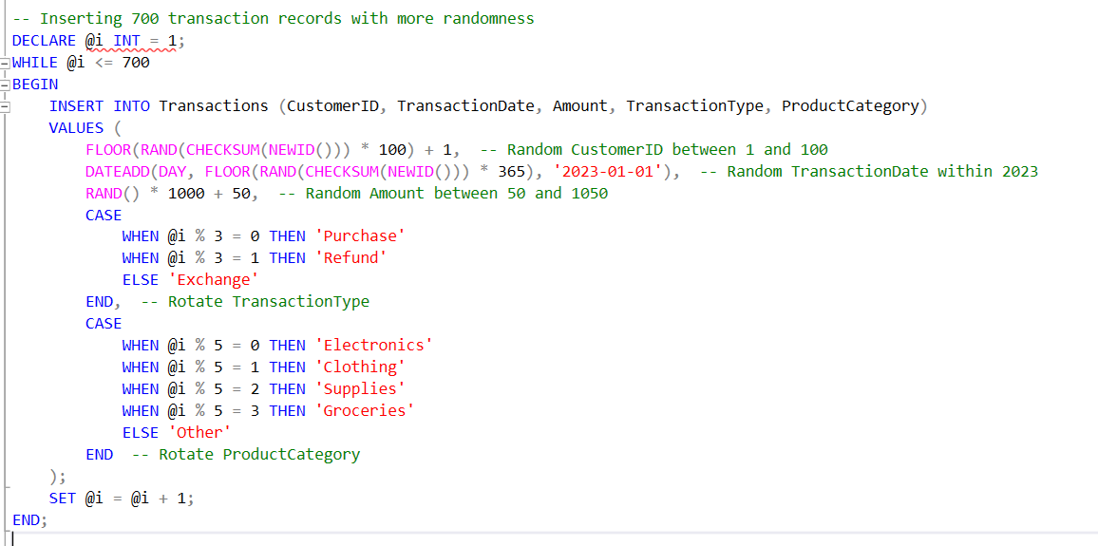

Slide 12
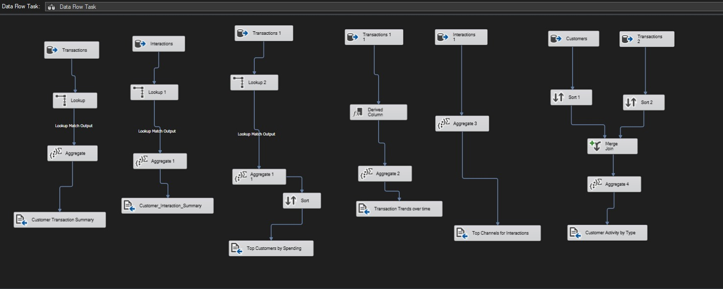
SSIS (Pipelines)

Slide 13
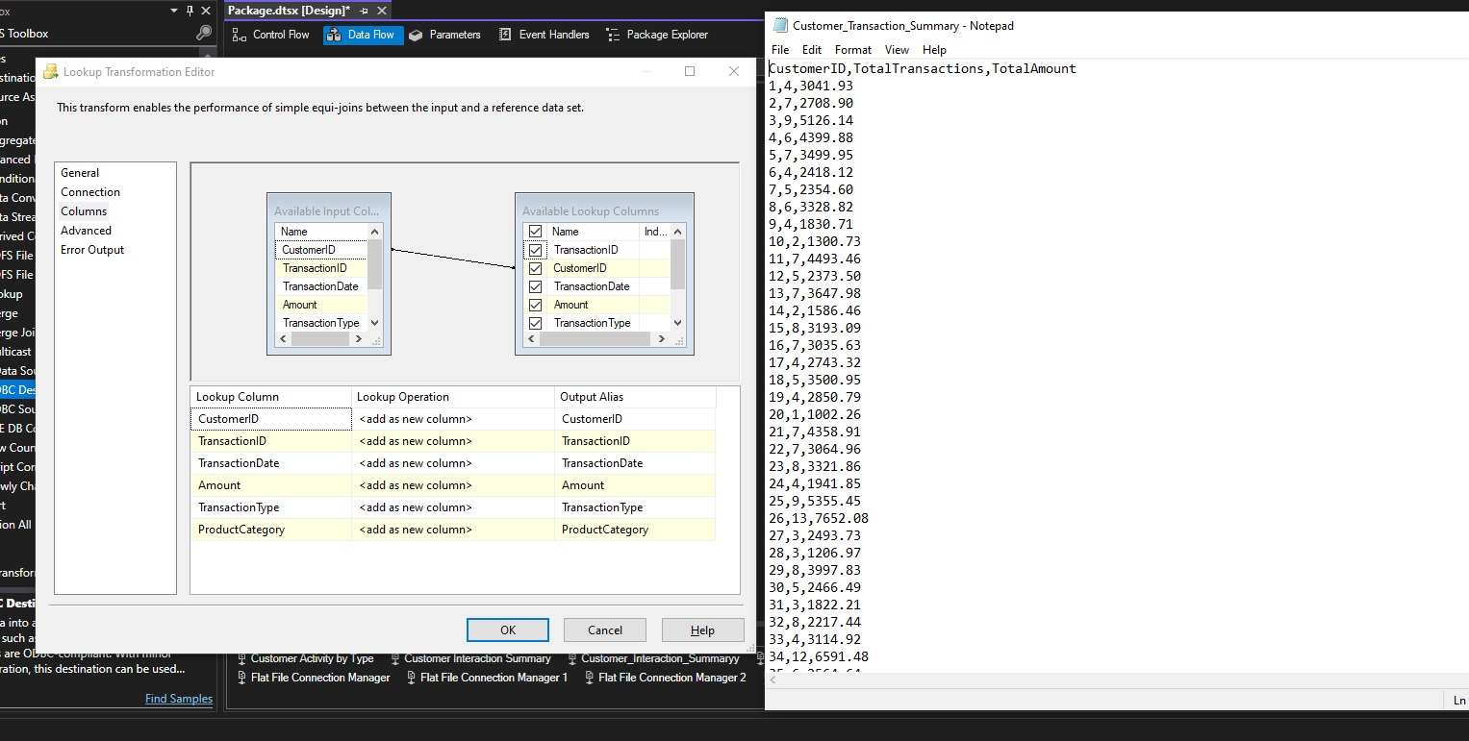
Custimomer transaction summary

Slide 14
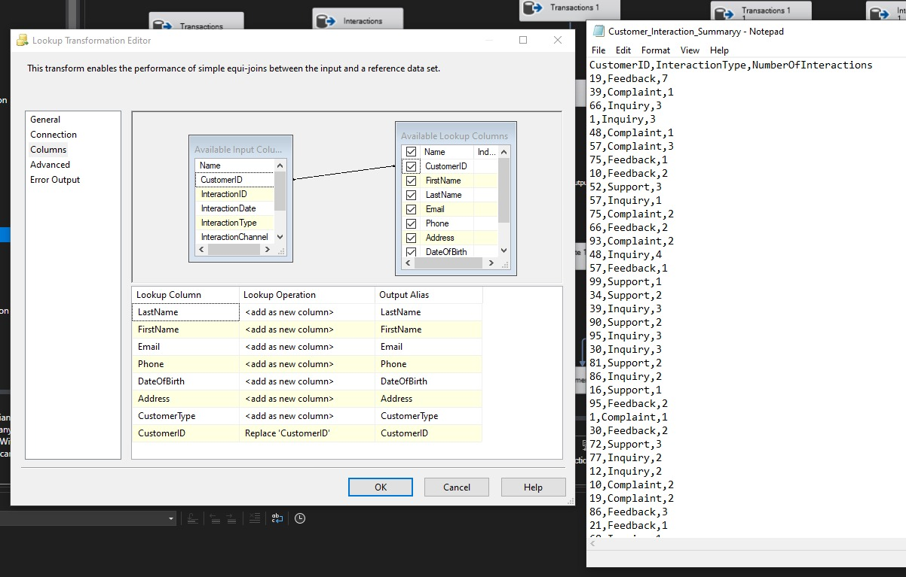
customer interaction summary

Slide 15
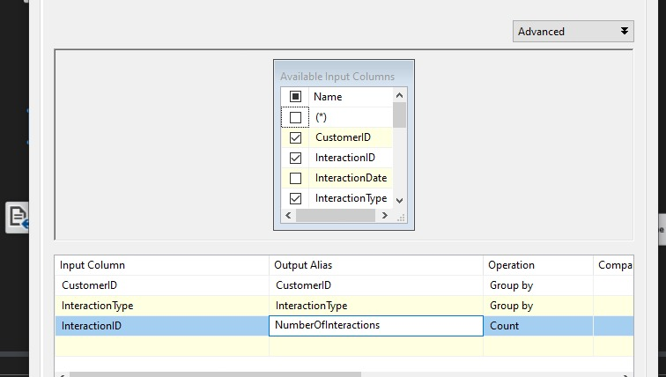

Slide 16
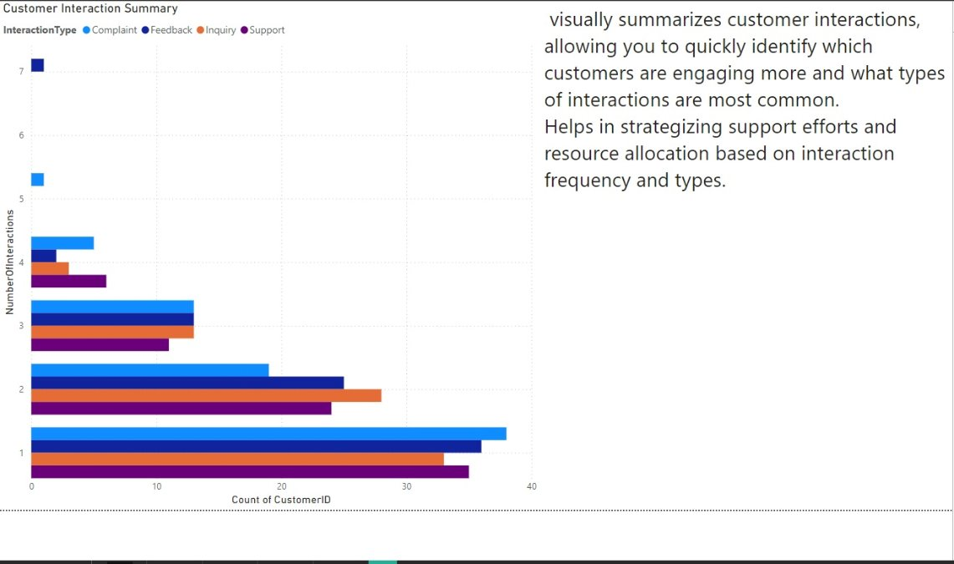

Slide 17
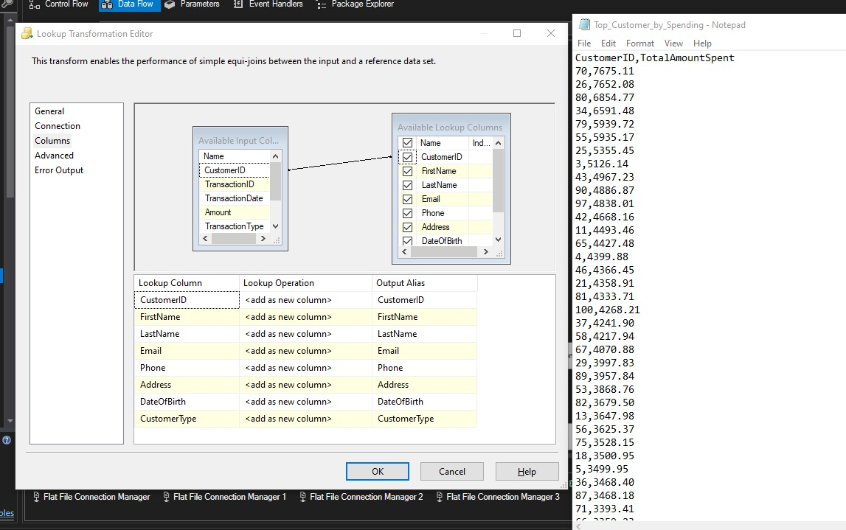
TOP customers by spending

Slide 18
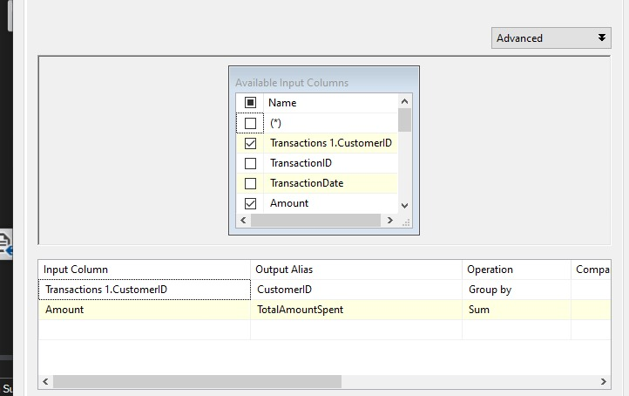

Slide 19
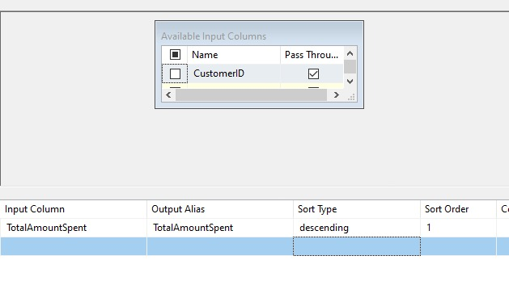

Slide 20
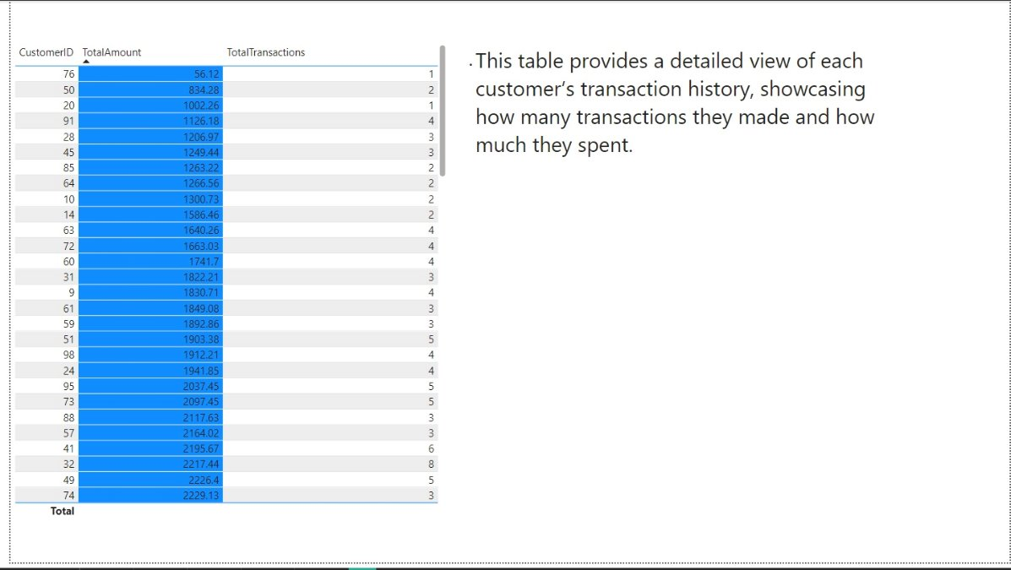

Slide 21
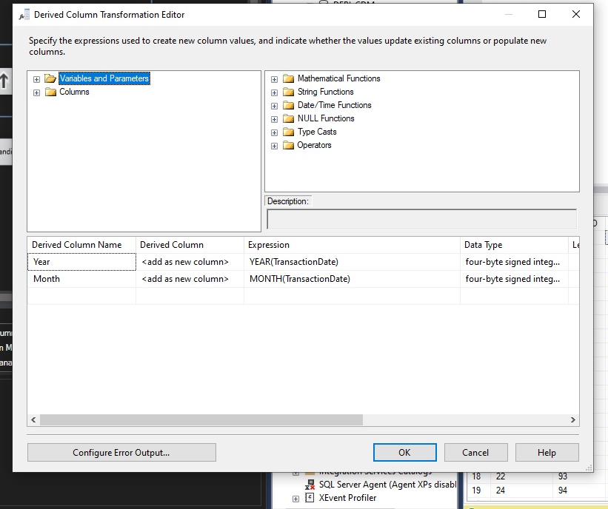
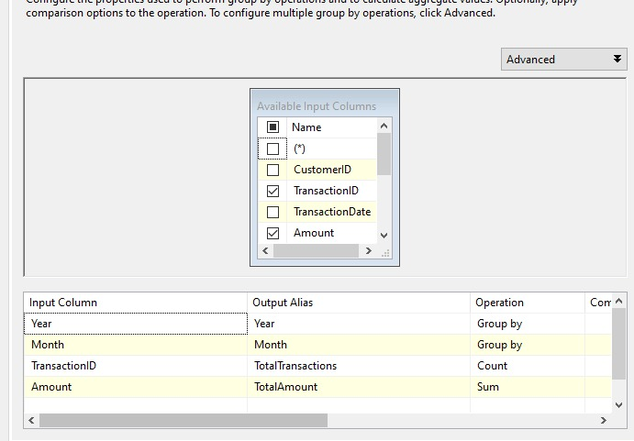
divide into groups grouped by year and month

Slide 22
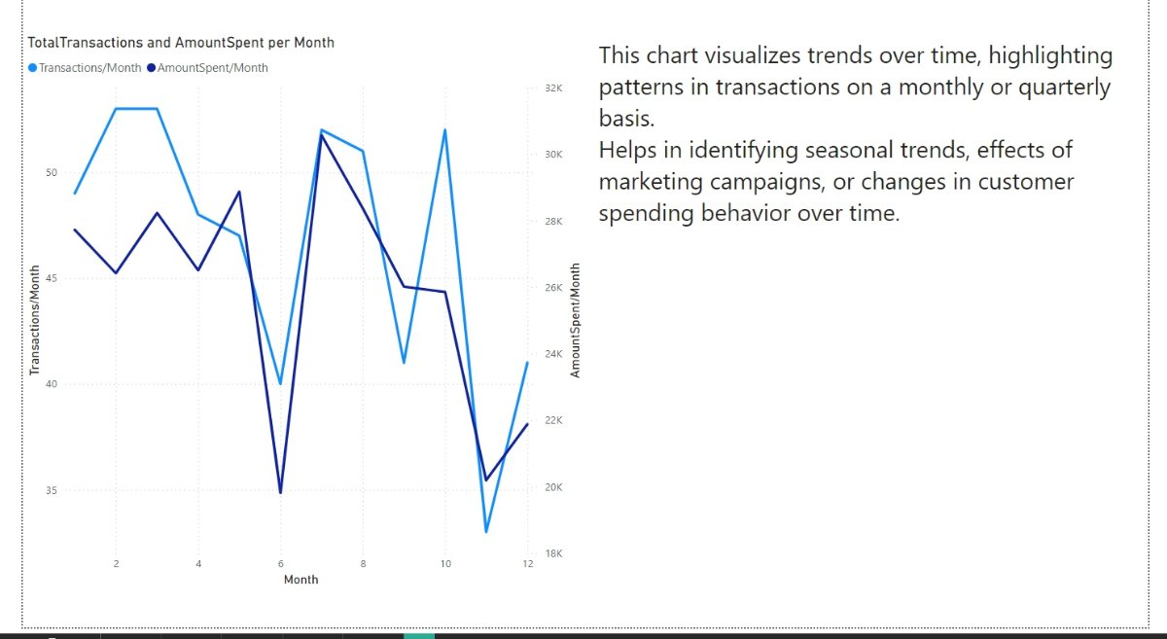

Slide 23
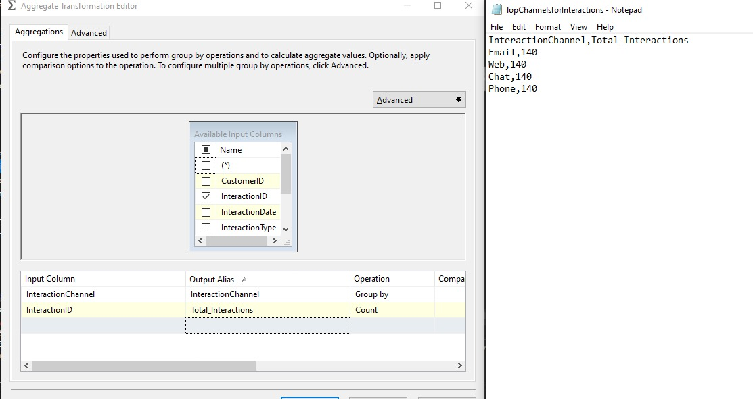
TOP channels for interactions

Slide 24
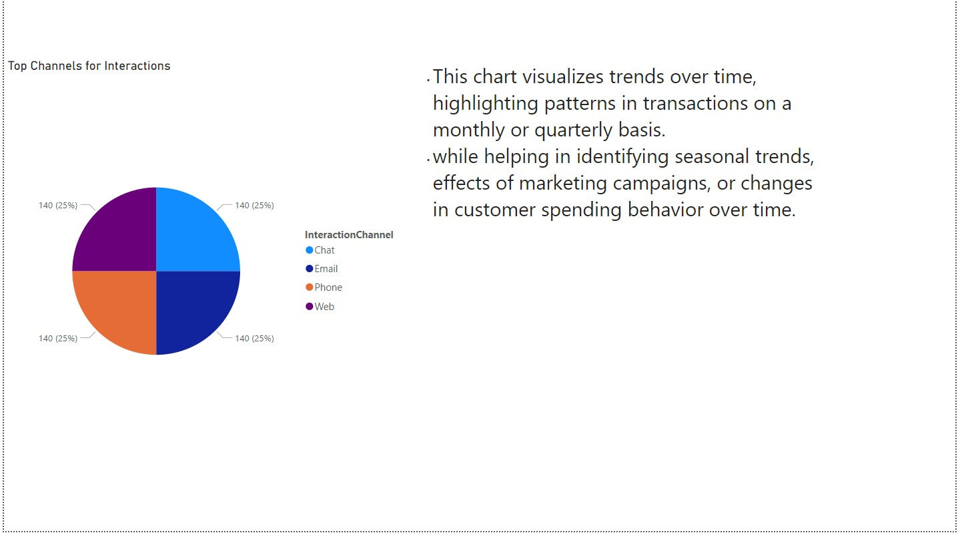

Slide 25
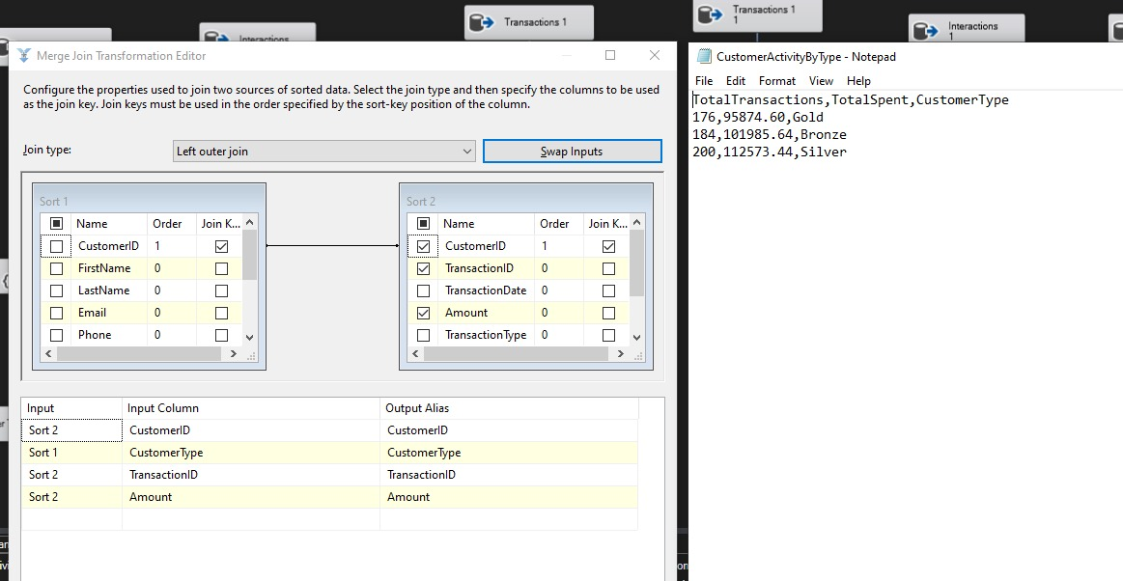
Customer Activity by Type

Slide 26
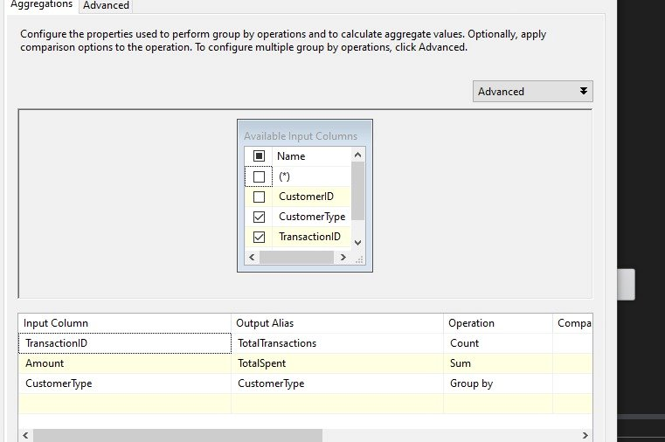

Slide 27
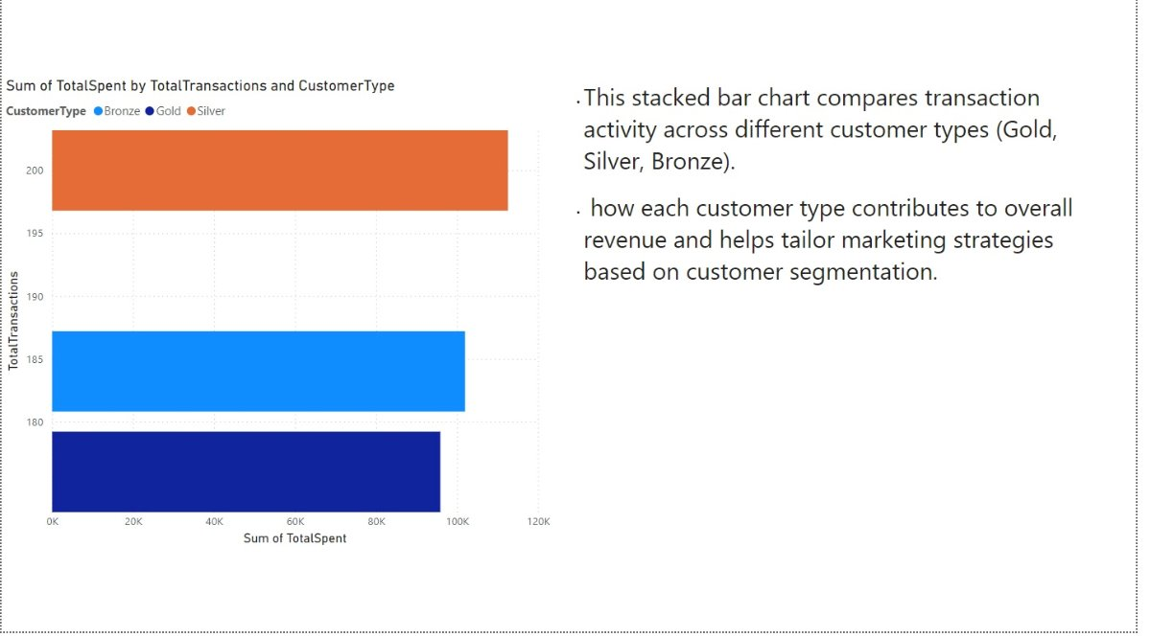

Slide 28


